Slide 1




Family Information Session
Use this template to create your own presentation Regional Association mentors or families starting a family council
Zoom meeting

Slide 2
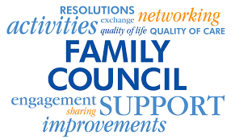
Family Information Session Starting a Family Council LTCH
Designed by VCAFC especially for LTCH DATE ___ VCAFC vcafc.regional@gmail.com Website: https://vancouvercoastalfamilycouncils.ca/ Facebook: https://www.facebook.com/VCAFC
Zoom meeting

Slide 3

Vancouver Coastal Association of Family Councils
What is VCAFC?
● Represents member Councils from long term care homes throughout VCH.
What is the purpose of VCAFC?
● Short answer: Networking, Knowledge-Sharing, Education and Advocacy
What specific work does VCAFC do?
• Provide guidance, education, and support to our member family councils just as individual family councils do in their own care homes AND we elevate these conversations to our govt LTC representatives.
Our organization and How to Reach us: ILTCCABC Website: https://iltccabc.ca/ Email: vcafc.regional@gmail.com Facebook: https://www.facebook.com/VCAFC

Slide 4
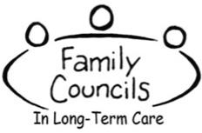

FAMILY COUNCIL is forum for families and representatives of residents that meet on a regular basis to maintain and enhance the quality of life of residents through peer support and education and provide voices for residents and families to improve the experiences of all residents. Family Council collaborates with LTCH leadership who provide Family Council with a voice in decision-making that affects resident quality of life.

Slide 5


WHAT DO FAMILY COUNCILS DO?
Deepen relationships between resident, family, and long-term care home staff by fostering mutual understanding and collaborative conversation; Problem Solve: Identify issues and celebrate successes; advocate for continuous improvement within the long-term care home; Communicate, Educate and Elevate: - about your care home (policies, care team, etc.) - about issues relating to residents and the long term care system; - elevate systemic issues up through the regional and
provincial level
Encourage and offer direction for one another; reducing sense of isolation, helplessness, frustration;

Slide 6

Your regional association supports Family Councils and Long-Term Care Homes. Information is key!

Slide 7

BENEFITS OF A FAMILY COUNCIL to Residents and Families
Provides family peer support, encouragement and direction;
Provides education on topics related to common resident challenges; Example: Dementia – how get more out of your visit
Gives families a place to constructively channel their concerns; then share collective issues with senior leadership for resolution; resulting in improved resident care and quality of life;
Reduces sense of isolation, helplessness, frustration supporting families to feel better about their caregiving role;
Gives families an opportunity to shape care home policies and procedures affecting their loved ones;

Slide 8

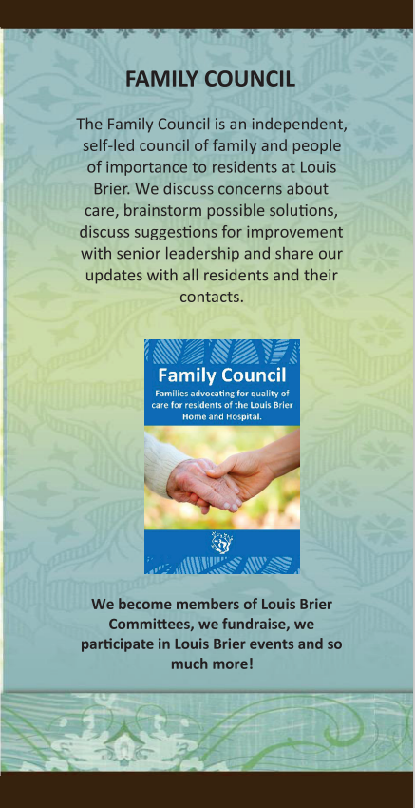

Slide 9

BENEFITS OF A FAMILY COUNCIL
To the Long-Term Care Home Community
More effectively crafted and implemented new policies having had input from stakeholders prior to roll out;
Acts as a triage, providing families direct support often fixing problems before they escalate to Administration;
Provides creative solutions to problems offered alongside expressions of concern;
Families can be engaged in committees, surveys and other ongoing quality improvement initiatives;
Family Councils can elevate the voice of the long-term care home to regional meetings and Ministry of Health

Slide 10
Understanding the Ministry of Health regulations behind the Family Council
- MOH news release about the changes in regs, - Statement from Dix, - Statement from each Regional Association of Family Councils: In the MoH media release Nov 3,2022, Minster Dix stated “Long-term care residences are people’s homes and it’s important that residents and family members have a place to share concerns and ideas when it comes to decisions about how the homes are operating.” The revised regulations will ensure members have more access to information and can have frank conversations about their experiences.”

Slide 11
Understanding the Ministry of Health regulations behind a
Family Council
THE WHAT Community Care and Assisted Living Act
RESIDENTIAL CARE REGULATION
[Last amended October 24, 2022 by B.C. Reg. 208/2022]
https://www.bclaws.gov.bc.ca/civix/document/id/complete/statreg/96_2009#section59
THE HOW MOH Guidelines: Developing, Supporting and Maintaining Resident and Family Councils

Slide 12
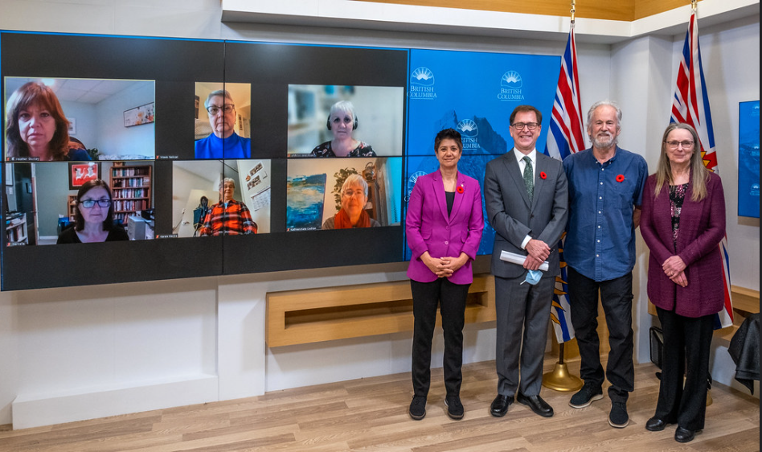
November 3, 2022 Changes to the Community Care and Assisted Living Act
RESIDENTIAL CARE REGULATION
● Through regulations, government will ensure resident and family councils are able to meet without licensees if preferred.
● The goal is to ensure council members are supported to have honest, open discussions.
● Care-home licensees will be required to provide, without cost, administrative support of an employee who is approved by the council for the council meeting.
● Care-home licensees will be required to provide access to a meeting room on the premises for up to three hours and equipment for the council meeting.
● Licensee of LTC homes will be required to respond in writing to all recommendations brought forward by the resident and family councils.
● The Ministry of Health is developing improved information resources for resident and family council members.
● The Ministry of Health will also provide a description of the council roles and responsibilities with focus on education, knowledge sharing, understanding residents’ rights and discussing best practices and systemic issues that are of interest to residents and their families to enhance quality of life for residents.
● Licensees/licensees will be obligated to share information from the Ministry of Health and the seniors advocate with members of the resident and family councils.
● Each health authority will be required to establish regional resident and family councils that will be co-chaired by a representative from the LTC council chairs and the health authority.
● The purpose of the regional council is to identify challenges and best practices at the local resident and family council level.

Slide 13



Show of Interest
Q&As
Important Documents

Slide 14
Next Step: Establish the Family Council
Find your key families who wish to start the Family Council,
Settle on your governing documents,
Send Notice of meeting to establish a Family Council along with those documents;
Vote to establish a Family Council,
Introduce candidates for Executive,
Vote in Executive team,
Voila! Your Family Council is formed!
Set next date and agenda for your meeting.
Enjoy volunteering, supporting, learning, improving, and taking part in something that can affect positive change in long term care everywhere!

Slide 15

FAMILY COUNCIL Sample Meeting Structure
Determine a chair to be the main contact for Family Council and to the long-term care home delegate.
Hold regular (monthly) meetings, Work with your care home to provide a meeting room (virtual zoom room or in person)
Family Council is run by families with the support of a staff liaison, for the benefit of residents
Effective meetings and Key tools: - Agendas - Minutes - Terms of Reference - Code of Conduct

Slide 16
Your care home supports Family Council by:
Promoting information and education about the Family Council to families, Resident Council and staff;
Following the BC Community Care and Assisted Living Act
RESIDENTIAL CARE REGULATION
Providing a place to meet and/or virtual meeting access and distribution of meeting notices, agendas and minutes;
Engaging in a regular form of dialogue between family council and senior leadership;
Seeking ways to engage resident and families

Slide 17

The regional association of family councils supports you
TIPS FOR HOLDING A (VIRTUAL) COUNCIL MEETING HOW TO MEASURE EFFECTIVENESS – UBC RESEARCH ADDRESSING HOT TOPICS
APRECIATIVE INQUIRY APPROACH AND THE RELATIONAL APPROACH HOW TO ENCOURAGE PARTICIPATION MEETING TEMPLATES SUCH AS: AGENDA, MINUTES, POSTERS, NOTICES

Slide 18

THANK YOU LTCH! WE ARE ALL BETTER TOGETHER!
VCAFC.regional@gmail.com

