Slide 1


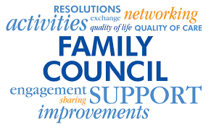


STARTING A FAMILY COUNCIL
Long-Term Care Home Staff
Designed by ILTCCABCC especially for (insert Long-Term Care Home)
ILTCCABC email: iltccabc@gmail.com
Website: https://iltccabc.ca/
Zoom meeting

Slide 2


What is a Family Council?
FAMILY COUNCIL is a self-directed group of people (family, friends or representatives of residents in long-term care) who meet regularly to promote the collective interests of residents.
  Goal: to improve the quality of care and quality of life of the residents; and
  Purpose: to provide families with a voice in decision-making that affects them and their loved ones.

Slide 3
What is a Family Council
NOT?
FAMILY COUNCIL
is/does not:
● run by the care home
● a decision-making body
● akin to a town hall or care home meeting
● get involved with HR decisions unless requested
● tell staff/management how to conduct their work
● engage in disrespectful behaviour (yelling, bullying, harassment)

Slide 4
Regional Association of Family Councils
What is a regional association (RA) of family councils?
● Represents member Councils from long term care homes throughout one of the 5 health authority regions in BC. While independent of the health authority, the RA is viewed by the Ministry of Health as a stakeholder in long-term care.
What is the purpose of each of the RAs?
● Short answer: Networking, Knowledge-Sharing, Education and Advocacy
What specific work does the RA do?
• Provide guidance, education, and support to start and maintain family councils; just as individual family councils do with their families in their own care homes.
• Elevate regional forum conversations about successes, barriers and long-term care systemic issues to the Independent Long-Term Care Councils Association of BC (ILTCCABC)
Our organization and How to Reach us:
ILTCCABC Website: https://iltccabc.ca/

Slide 5

WHAT DO FAMILY COUNCILS DO?
  Promote improved communication & collaboration between residents, families and staff.
  Engage with decision makers on ideas to enrich the lives of residents.
  Advocate for positive change within Long-Term Care Home and the long-term care system.
  Educate and inform families about issues relating to residents, Long-Term Care Home and the long-term care system.

Slide 6
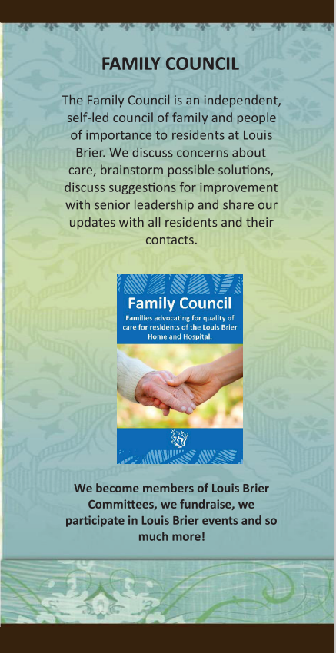


Slide 7

BENEFITS OF FAMILY COUNCIL
Promotes open lines of communication
Builds a trusted relationship
Creates a sense of community
Increases the likelihood that new policies will be implemented successfully and positively impact residents because families will have had an opportunity to comment on and shape these policies;
Acts as a triage, providing families direct support, often fixing problems before they escalate to Administration;
Gives honest input feedback to use for ongoing quality improvement;
For Residents (Most Important of All!)
Improves Residents’ quality of life!!!!

Slide 8
In the Ministry of Health media release Nov 3,2022,
Minster Dix stated
“Long-term care residences are people’s homes and it’s important that residents and family members have a place to share concerns and ideas when it comes to decisions about how the homes are operating.” The revised regulations will ensure members have more access to information and can have frank conversations about their experiences.
Why Encourage and Support Family Councils?

Slide 9
Understanding the Ministry of Health regulations behind a
Family Council
THE WHAT
Community Care and Assisted Living Act
RESIDENTIAL CARE REGULATION
[Last amended October 24, 2022 by B.C. Reg. 208/2022]
https://www.bclaws.gov.bc.ca/civix/document/id/complete/statreg/96_2009#section59
THE HOW
MOH Guidelines:
Developing, Supporting and Maintaining Resident and Family Councils

Slide 10
Long-Term Care Homes Support Family Council by:
  Promoting information and education about the Family Council to families, Resident Council and staff;
  Following the BC Community Care and Assisted Living Act
  RESIDENTIAL CARE REGULATION
  Providing a place to meet and/or virtual meeting access and distribution of meeting notices, agendas and minutes;
  Engaging in a regular form of dialogue between family council and senior leadership;
  Seeking ways to engage resident and families

Slide 11
Meeting #1 Family Information Session with support from your regional association
Hold a Family Information Session
Inform about the opportunity to establish a Family Council.
Maximize attendance: lead time, reminder, hybrid (virtual and in person) meeting, late afternoon, evening
At the meeting inspire Q&A, alleviating concerns/fear and instilling confidence and pride
Ask for a show of interest (straw vote) for a Family Council
Ask who may be interested to lead the family council.
Send out a notice asking for an expression of interest to establish the Family Council

Slide 12
Meeting #2
Establish the Family Council with support from your regional association
Interested families and regional association meet
Create Terms of Reference and Code of Conduct, confirm supports
Set a date/time to invite all families to the first council meeting,
Meeting: Introduce candidates for Executive,
Define the council as per governance documents
Vote the council in as presented
Set next date and agenda for your meeting and start sharing.
Enjoy taking part in something that can affect positive change in long term care everywhere!

Slide 13

The regional association of family councils supports you
TIPS FOR HOLDING A (VIRTUAL) COUNCIL MEETING
HOW TO MEASURE EFFECTIVENESS
ADDRESSING HOT TOPICS
HOW TO ENCOURAGE PARTICIPATION
MEETING TEMPLATES SUCH AS:
AGENDA, MINUTES, POSTERS,
NOTICES

Slide 14


THANK YOU
Long-Term Care Home!
WE ARE ALL BETTER TOGETHER!
ILTCCABC: https://iltccabc.ca/

