Slide 1

Personalized approach to Social Isolation
Presented by:
Dennis Natembeya (M.Sc(c), Uvic, RN
Tosin Ajayi (M.Sc., M.Eng., UBC) PMP

Slide 2

Our Journey
How LinkRx Ideated
Pre and Post Covid
Partners: Langley Lodge, Rosemary Heights (Retirement Concepts), Louis Brier Home and Hospital
Our Support Partners: Center for Brain Health and Innovation (CABHI)
Notes:
Multi-lingual, Loneliness staffing issues,

Slide 3
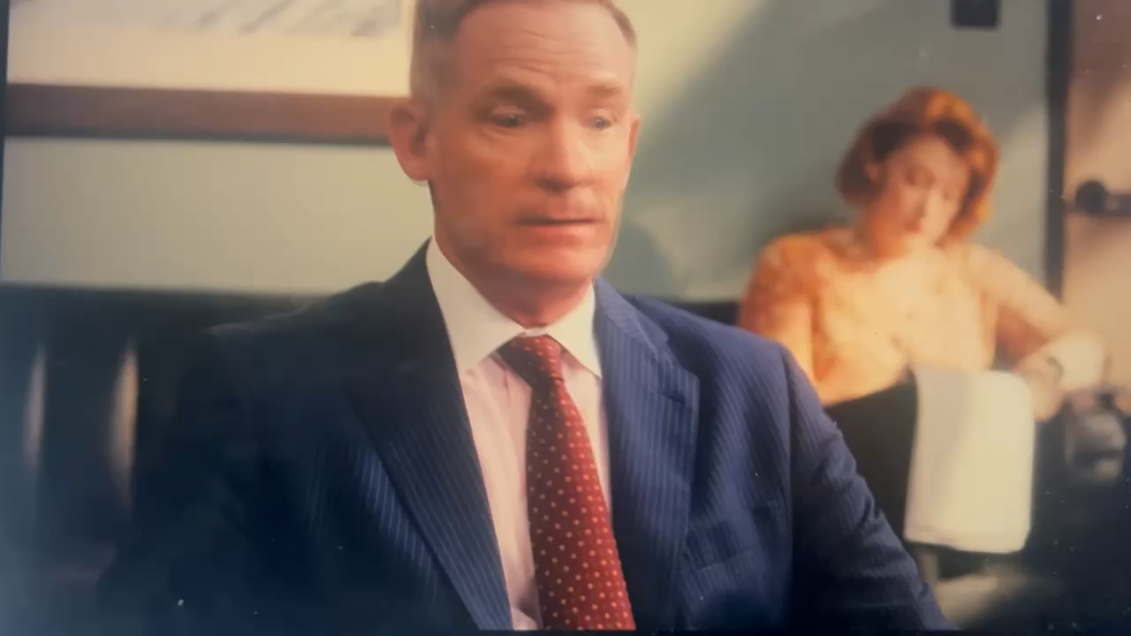
Notes:
Reference : Man on the Inside on Netflix 2024 episode 8

Slide 4
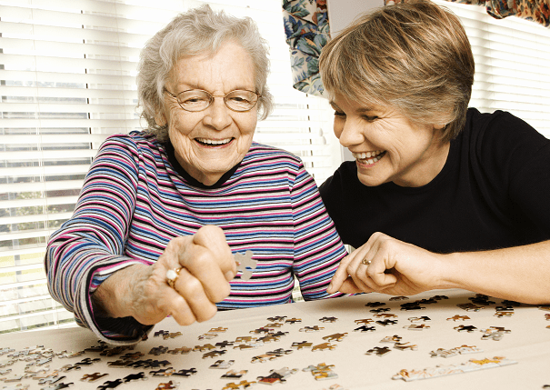
Vision:
Meaningful connections for residents in care, adding engagement, well-being, and social support to care.

Slide 5
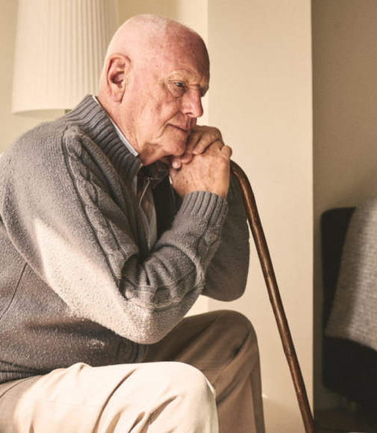
Every Senior Deserves More Than Clinical Care – They Deserve Connection.
Up to 10 hours of loneliness daily
No consistent companionship.
Limited care staff to support engagement.
Limited Activities.
Two-thirds of residents in BC answer only ‘sometimes’, ‘rarely’ or ‘never’ do they find enjoyable things to do on evenings and weekends, or find opportunities to explore new skills or interests. https://www.seniorsadvocatebc.ca/?s=long-term+care

Slide 6
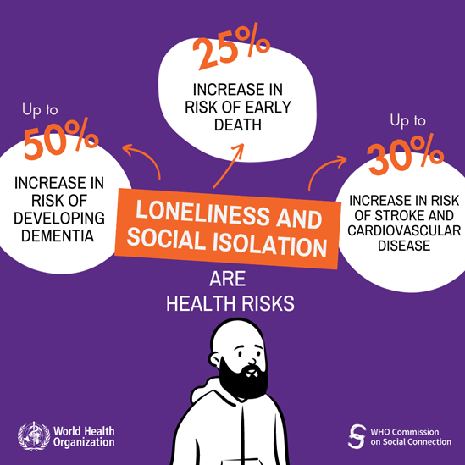
Why it Matters
Notes:
Santini, Z. I., Jose, P. E., York Cornwell, E., Koyanagi, A., Nielsen, L., Hinrichsen, C., Meilstrup, C., Madsen, K. R., & Koushede, V. (2020). Social disconnectedness, perceived isolation, and symptoms of depression and anxiety among older Americans (NSHAP): a longitudinal mediation analysis. The Lancet. Public health, 5(1), e62–e70. https://doi.org/10.1016/S2468-2667(19)30230-0
An 87-year-old woman residing in an LTC facility was isolated from family because of restriction /covid related. She stopped eating, lack of appetite.As a result, increased depression and cognition-hence increase in SSRI and α-2 antagonist(Antidepresants)
evenentually PHQ increased from 5-12 (from mild depression to Moderate)
https://bmcgeriatr.biomedcentral.com/articles/10.1186/s12877-021-02718-5
Chamberlain, S. A., Bronskill, S. E., Hsu, Z., Youngson, E., & Gruneir, A. (2022). Resident loneliness, social isolation and unplanned emergency department visits from supportive living facilities: a population-based study in Alberta, Canada. BMC geriatrics, 22(1), 21. https://doi.org/10.1186/s12877-021-02718-5

Slide 7
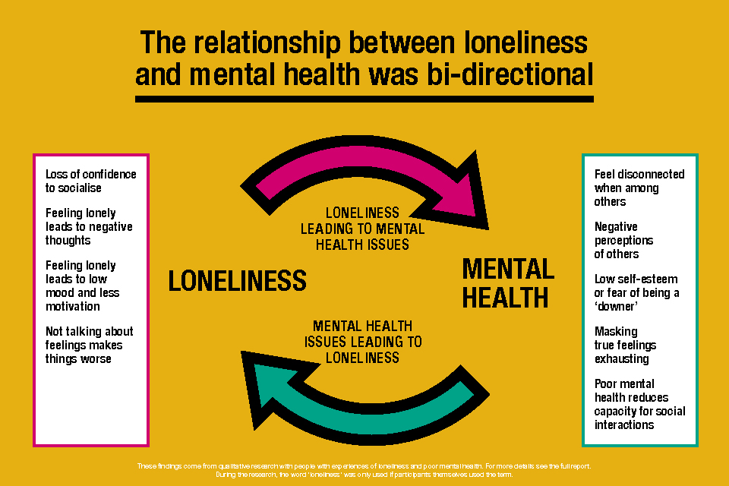
Cont.. Why it Matters
Loneliness increases depressive and anxiety symptoms (Santini et al., 2020)
Social disconnectedness predicted higher subsequent perceived isolation-leading to depression.
Poor mental stimulation increase medication
Lack of social interaction can lead in exist seeking behaviour and reduced decline in mental stimulation.
Limited access to healthcare resources and social appointments
Burdened clinical staff leads to reduced quality of care
Loss of engagement and purpose.
Notes:
Santini, Z. I., Jose, P. E., York Cornwell, E., Koyanagi, A., Nielsen, L., Hinrichsen, C., Meilstrup, C., Madsen, K. R., & Koushede, V. (2020). Social disconnectedness, perceived isolation, and symptoms of depression and anxiety among older Americans (NSHAP): a longitudinal mediation analysis. The Lancet. Public health, 5(1), e62–e70. https://doi.org/10.1016/S2468-2667(19)30230-0
An 87-year-old woman residing in an LTC facility was isolated from family because of restriction /covid related. She stopped eating, lack of appetite.As a result, increased depression and cognition-hence increase in SSRI and α-2 antagonist(Antidepresants)
evenentually PHQ increased from 5-12 (from mild depression to Moderate)
https://bmcgeriatr.biomedcentral.com/articles/10.1186/s12877-021-02718-5
Chamberlain, S. A., Bronskill, S. E., Hsu, Z., Youngson, E., & Gruneir, A. (2022). Resident loneliness, social isolation and unplanned emergency department visits from supportive living facilities: a population-based study in Alberta, Canada. BMC geriatrics, 22(1), 21. https://doi.org/10.1186/s12877-021-02718-5

Slide 8

Current Approach and Gaps
Group activities
Non – personalised, limited staff.
Visits or Friends when a resident has a network.
Geographically Limited
Family is busy
Limited visit times.
Unreliable companion services
No continuity of connections
Poor accessibility to companions
Expensive
Invisible - No feedback channels to families and Facilities.
Unreliable channel of connection between the family and residents.
Reduced social contact.

Slide 9

Our Approach: Steps to Meaningful Connections and Activities
Identify the need - Families and Facilities
1
We create a personal social profile
2
Connect with right companion.
3
Support resident.
4
Get feedback.

Slide 10
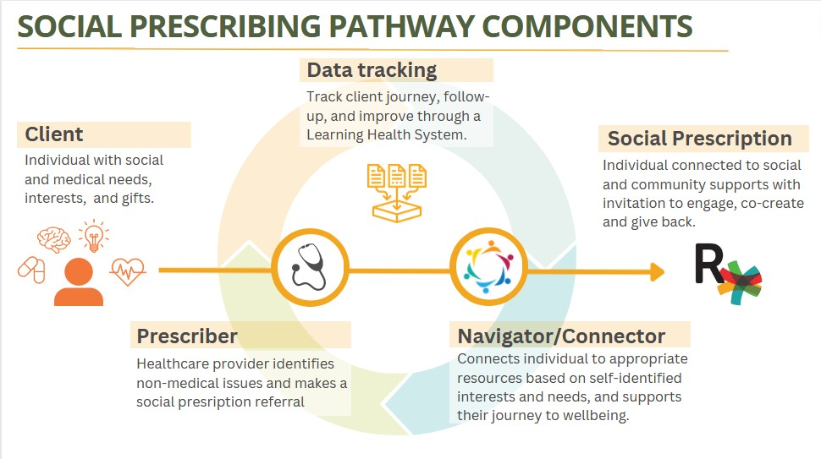

Slide 11
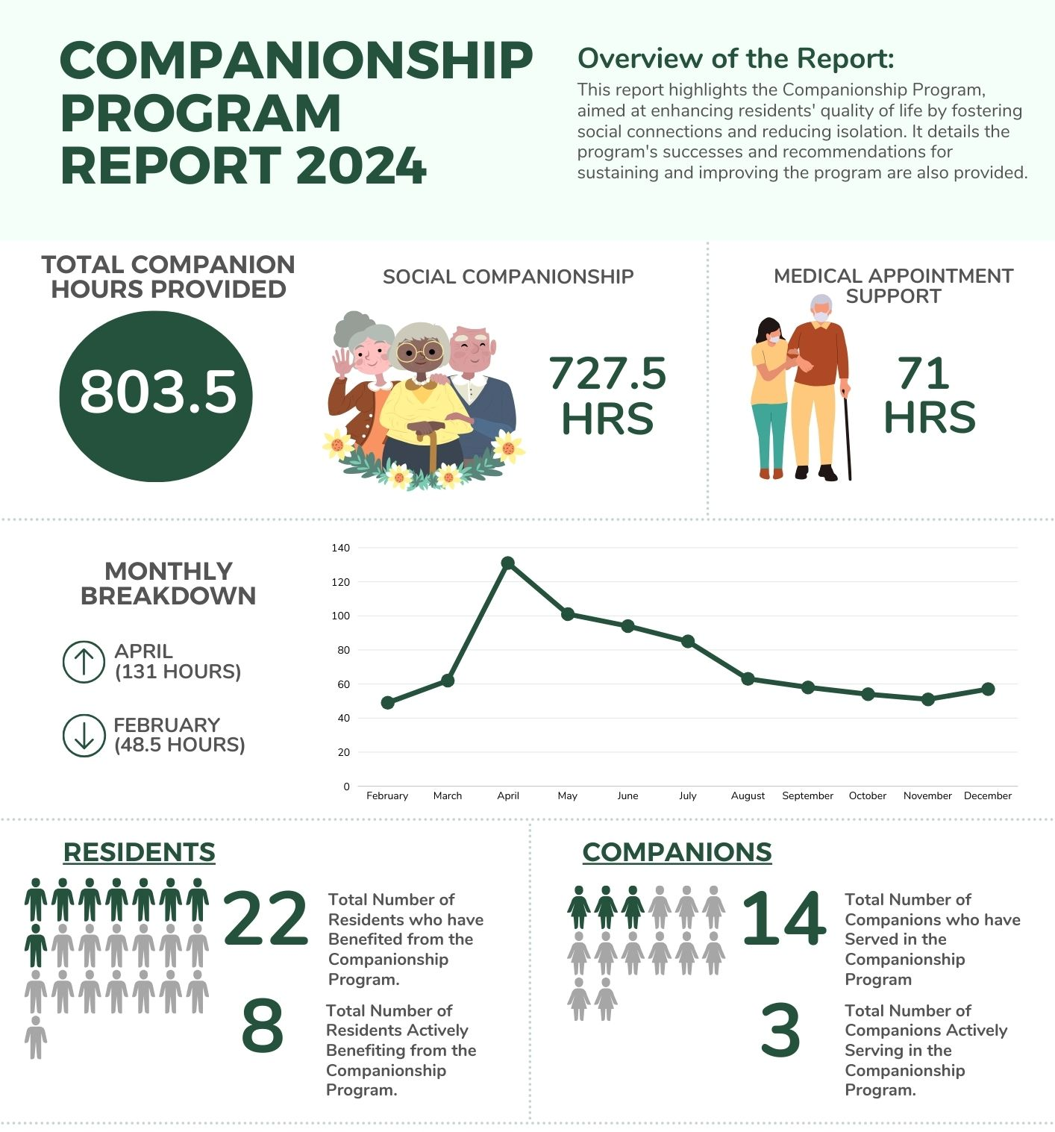

Typical service report for one of our facilities.
Notes:
Typical service report for one of our facilities.

Slide 12

Engagement That Inspires and Connects.
Social visits when you cannot be there or live too far away
Meal-time feeding or support
Walking buddy
Cultural activities (church, temple or indigenous celebrations)
Support to and during appointments and recreation activities.

Slide 13

Engagement That Inspires and Connects.
Celebration of special moments like birthdays and holidays(Christmas, Diwali)
Daily walks and outdoor activities.
Virtual tech support to connect with families(Tablets)
Games and meaningful conversations.

Slide 14
Peace of Mind, Every Step of the Way.
Choose your companion based on shared interests.
We book services quickly and securely through our platform.
Enjoy updates and track engagement.
Affordable services starting at $29/hour.
Secure payments through our system (get secure link to pay and invoices monthly).
Flexible scheduling.(minimum of 2hrs per session )

Slide 15
LinkRx Key Pillars
Focus on reducing isolation to enhance emotional and physical health.
Personalized, trained, and insured companions.
Easy-to-use technology, we book and manage services for families.
Notes:
Client is the Resident
Prescriber; nurse
Navigator connects to Link worker
carry out the prescription.

Slide 16

How it works!
Explore Companion online on Linkrx portal
Confirm a schedule(call us)
Enjoy the support
Start today

Slide 17

Here to support you!
Practical
Using technology to improve human connection.
Actionable
Easy to execute in care facilities.
Accountable
Providing visits notes to families for continuity of connections.
Accessible
Visible and easy to reach companions in one place on the platform.
Affordable
Sustainable pricing for families.

Slide 18


Co-Founders & Sponsor
Dennis RN M.Sc.(c) - UVIC
Role/Focus: Compassion and Clinical Expertise
Attributes: Emphasizes Empathy, Patient Care, and Clinical insights.
Tosin M.Sc. - UBC
Role/Focus: Action-Oriented Leader
Attributes: Takes Initiative, Drives Tasks Forward, Ensures Quality Execution.
Alani Adeshina M.Sc. - UVIC
Role/Focus: Technology Master
Attributes: Handles Technical Challenges, Innovation, and System improvements.

Slide 19
Connect with us!
Thank you!
Contact:
Dennis: Contact@linkrx.ca | 778-318-4402
Tosin: tosina@linkrx.ca| 604-338-309
Linkrx.ca

Slide 20
Questions?

